Slide 1
SMART Vehicles & HELMETS
CREATED TO SAVE LIVES

Slide 2
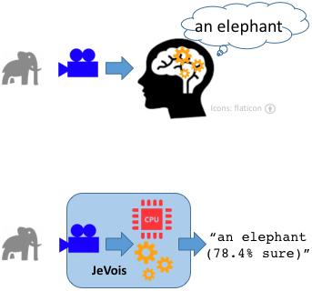
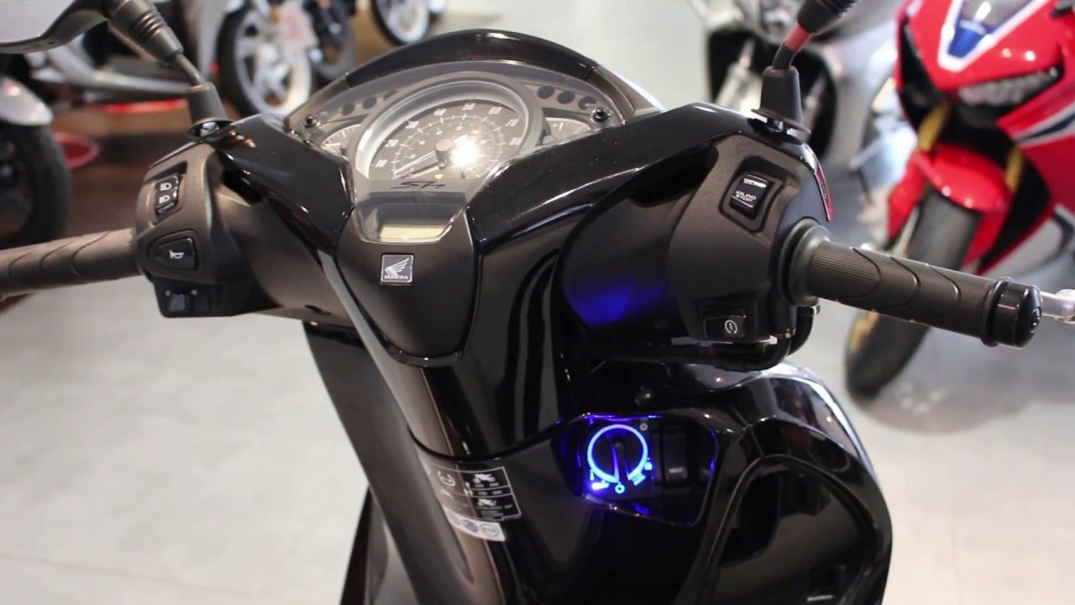
Jevois SMART CAMERA : keyFob :
> Standard Camera : Captures video , Sends video to human user
& Human brain interprets what the video contain.
> JeVois Smart Camera : Captures video , Processes video to interpret
contents & Sends interpretation to human, robot, or another computer.
> A key fob is a small, programmable hardware device that provides access
to a physical object.
> They can also be used as an authentication factor for objects that require
two-factor or multifactor authentication, such as laptops.

Slide 3
Solution : With HELMET : WITHOUT HELMET :
Helmet On The Persom
Camera
Key
Vehicle Starts
No Helmet
Camera
Key
Vehicle Starts

Slide 4
Thank you

